Slide 1
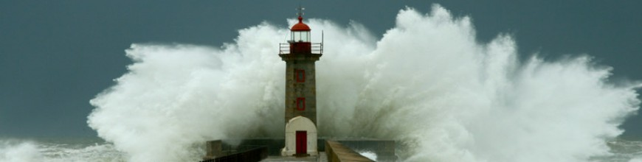
Jesus or Jezebel?
Revelation 2:18-29

Slide 2
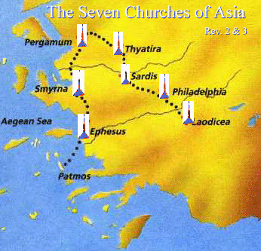

Slide 3
18 “And to the angel of the church in Thyatira write: ‘The words of the Son of God, who has eyes like a flame of fire, and whose feet are like burnished bronze.
19 “‘I know your works, your love and faith and service and patient endurance, and that your latter works exceed the first.

Slide 4
20 But I have this against you, that you tolerate that woman Jezebel, who calls herself a prophetess and is teaching and seducing my servants to practice sexual immorality and to eat food sacrificed to idols.

Slide 5
21 I gave her time to repent, but she refuses to repent of her sexual immorality. 22 Behold, I will throw her onto a sickbed, and those who commit adultery with her I will throw into great tribulation, unless they repent of her works, 23 and I will strike her children dead. And all the churches will know that I am he who searches mind and heart, and I will give to each of you according to your works.

Slide 6
24 But to the rest of you in Thyatira, who do not hold this teaching, who have not learned what some call the deep things of Satan, to you I say, I do not lay on you any other burden. 25 Only hold fast what you have until I come. 26 The one who conquers and who keeps my works until the end, to him I will give authority over the nations, 27 and he will rule them with a rod of iron, as when earthen pots are broken in pieces, even as I myself have received authority from my Father. 28 And I will give him the morning star. 29 He who has an ear, let him hear what the Spirit says to the churches.’

Slide 7
‘Only hold fast what you have until I come.’

