Slide 1
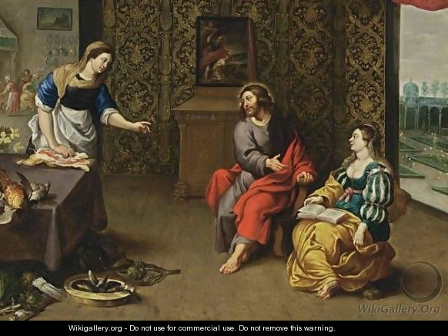
Mary and Martha
Luke 10:37-42

