Slide 1
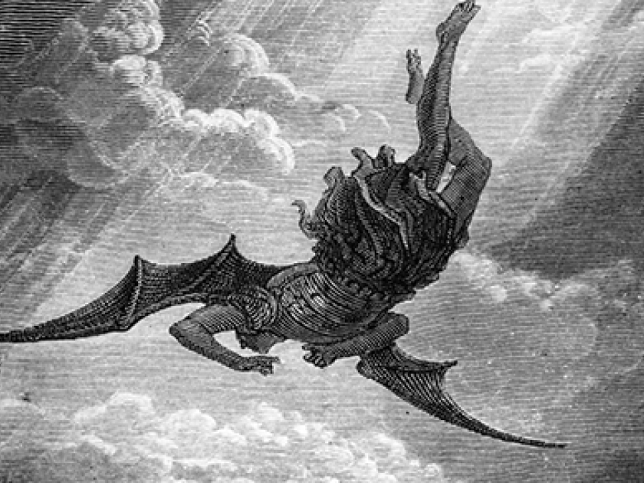
Rejoicing in Jesus’ Exclusive Salvation
Luke 10:17-24

