Slide 1
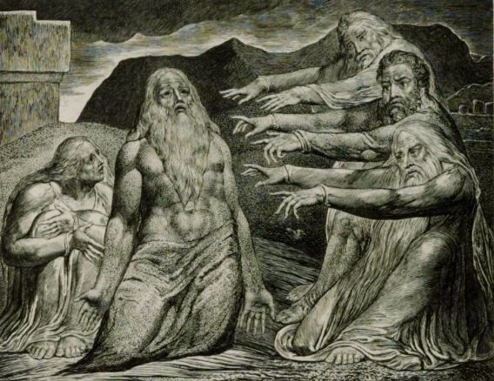
Being a Friend to Someone Who is Suffering
Job 2:11- 37:24

