Slide 1
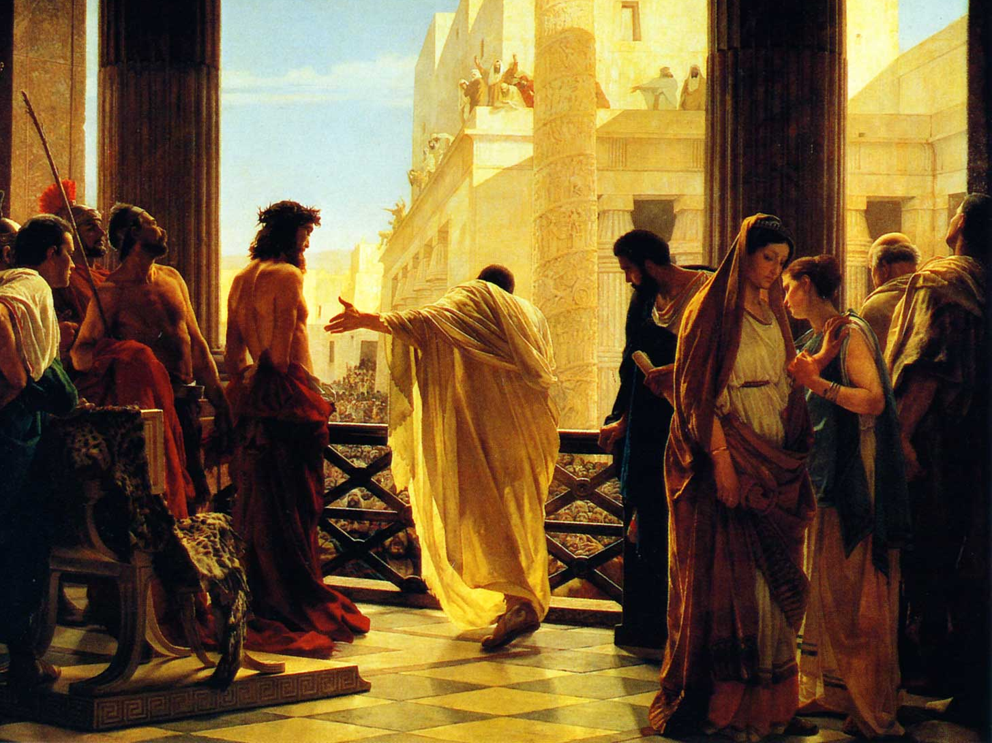
Jesus’ Crucifixion
What is your decision?
Luke 23

