Slide 1
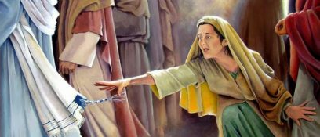
Jesus, Lord over Sickness
Luke 8:40-48

Slide 2

Luke 8:40-48
The woman’s desperate need
Her saving faith in Jesus
God’s gracious welcome
This Photo by Unknown Author is licensed under CC BY-NC-ND

