Slide 1
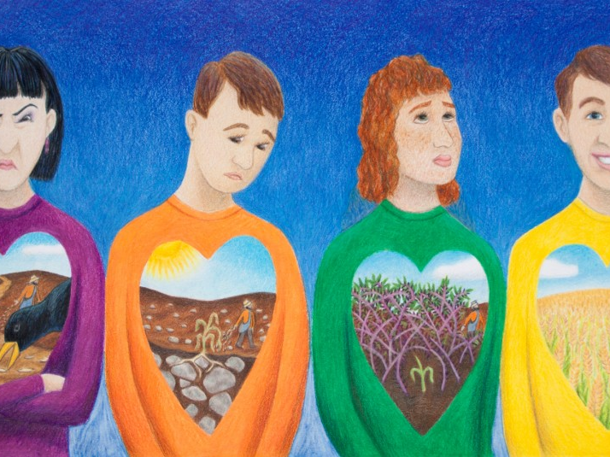
HAVING EARS THAT HEAR

Slide 2
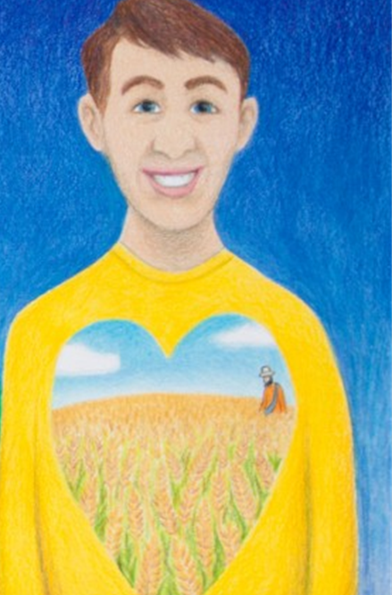
Luke 8:4-18
Understanding and becoming a fruitful hearer of God’s word

