Slide 1
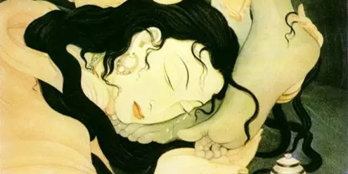
How Much Do You Love Jesus?
Luke 7:36-50

