Slide 1
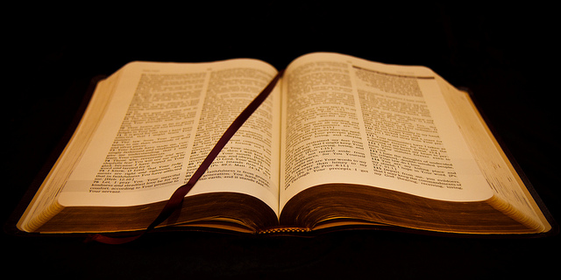
The God-Breathed Word
2 Timothy 3:16

