Slide 2
Ezekiel

Slide 3
Ezekiel 8
¹ In the sixth year, in the sixth month on the fifth day, while I was sitting in my house and the elders of Judah were sitting before me, the hand of the Sovereign Lord came on me there. ² I looked, and I saw a figure like that of a man. From what appeared to be his waist down he was like fire, and from there up his appearance was as bright as glowing metal. ³ He stretched out what looked like a hand and took me by the hair of my head. The Spirit lifted me up between earth and heaven and in visions of God he took me to Jerusalem, to the entrance of the north gate of the inner court, where the idol that provokes to jealousy stood.

Slide 4
Ezekiel 8
⁴ And there before me was the glory of the God of Israel, as in the vision I had seen in the plain.
⁵ Then he said to me, “Son of man, look toward the north.” So I looked, and in the entrance north of the gate of the altar I saw this idol of jealousy.
⁶ And He said to me, “Son of man, do you see what they are doing—the utterly detestable things the Israelites are doing here, things that will drive Me far from my sanctuary? But you will see things that are even more detestable.”

Slide 5
Ezekiel 8
⁷ Then he brought me to the entrance to the court. I looked, and I saw a hole in the wall. ⁸ He said to me, “Son of man, now dig into the wall.” So I dug into the wall and saw a doorway there.
⁹ And he said to me, “Go in and see the wicked and detestable things they are doing here.”
¹⁰ So I went in and looked, and I saw portrayed all over the walls all kinds of crawling things and detestable (unclean) animals and all the idols of Israel.
¹¹ In front of them stood seventy elders of Israel, and Jaazaniah son of Shaphan was standing among them. Each had a censerin his hand, and a fragrant cloud of incense was rising.

Slide 6
Ezekiel 8
¹² He said to me, “Son of man, have you seen what the elders of Israel are doing in the darkness, each at the shrine of his own idol?
They say, ‘The Lord does not see us;
the Lord has forsaken the land.’”
¹³ Again, he said, “You will see them doing things that are even more detestable.”

Slide 7
Ezekiel 8
¹⁴ Then he brought me to the entrance of the north gate of the house of the Lord, and I saw women sitting there, mourning the god Tammuz.¹⁵ He said to me, “Do you see this, son of man? You will see things that are even more detestable than this.”
¹⁶ He then brought me into the inner court of the house of the Lord, and there at the entrance to the temple, between the portico and the altar, were about twenty-five men. With their backs toward the temple of the Lord and their faces toward the east, they were bowing down to the sun in the east.

Slide 8
Ezekiel 8
¹⁷ He said to me, “Have you seen this, son of man? Is it a trivial matter for the people of Judah to do the detestable things they are doing here? Must they also fill the land with violence and continually arouse my anger? Look at them putting the branch to their nose!
¹⁸ Therefore I will deal with them in anger; I will not look on them with pity or spare them. Although they shout in my ears, I will not listen to them.”

Slide 10
Examine our Hearts
Ezekiel 8

Slide 11
Introduction to Ezekiel

Slide 12
Timeline of Ezekiel 8
Ezekiel 8:1 ‘In the 6th year…’

Slide 13
Timeline of Ezekiel 8
(592 BC)
Ezekiel 8:1 ‘In the 6th year…’
605 BC
597 BC
588 BC
1st Siege
Daniel taken captive
2nd Siege
3rd Siege
Jeremiah taken Captive
& Jerusalem destroyed
Ezekiel taken Captive
BABYLONIAN INVASION OF JERUSALEM

Slide 14
….these men have set up idols in their hearts.
What was the biggest problem?
Ezekiel 14:3

Slide 15
….these men have set up idols in their hearts.
Examine our Hearts
Ezekiel 14:3

Slide 16
Examine our Hearts
Ezekiel 14:6
‘Therefore say to the people of Israel,
“This is what the Sovereign Lord says:
Repent!
Turn from your idols…

Slide 17
Timeline of Ezekiel 8
(592 BC)
Ezekiel 8:1 ‘In the 6th year’
605 BC
597 BC
588 BC
1st Siege
Daniel taken captive
2nd Siege
3rd Siege
Jeremiah taken Captive
& Jerusalem destroyed
Ezekiel taken Captive
BABYLONIAN INVASION OF JERUSALEM

Slide 18
Ezekiel 8:1
In the 6th year, in the 6th month on the 5th day,
while I was sitting in my house
and the elders of Judah were sitting before me,
the hand of the Sovereign Lord came on me there.

Slide 19
Ezekiel 8:2
I looked, and I saw a figure
like that of a man.
From what appeared to be his waist down he was like fire, and
from there up his appearance was as bright as glowing metal.

Slide 20
Ezekiel 8:3
He stretched out what looked like a hand and took me by the hair of my head. The Spirit lifted me up between earth and heaven and in visions of God He took me to Jerusalem…..

Slide 21
Ezekiel 8:3b
….…The Spirit …… in visions of God .…
took me to Jerusalem
to the entrance of the north gate
of the inner court,
where the idol that provokes to jealousy stood.

Slide 22
Ezekiel 8v3-6
1st Challenge to Examine our hearts
Idol of Jealousy

Slide 23
Ezekiel 8v3-6
1st Challenge to Examine our hearts
Idol of Jealousy
God thinks it is
“utterly detestable”
Ezekiel 8:6
He really, really hates it

Slide 24
Ezekiel 8v3-6
1st Challenge to Examine our hearts
Idol of Jealousy
What is taking our love and worship from God?

Slide 25
Ezekiel 8v3-6
1st Challenge to Examine our hearts
Test 1:
What are the things I am spending the most time doing or thinking about?

Slide 26
Ezekiel 8v3-6
1st Challenge to Examine our hearts
Test 1:
What are the things I am spending the most time doing or thinking about?
Would I be prepared to live without it?

Slide 27
Ezekiel 8v3-6
1st Challenge to Examine our hearts
Test 2:
What do I really want?

Slide 28
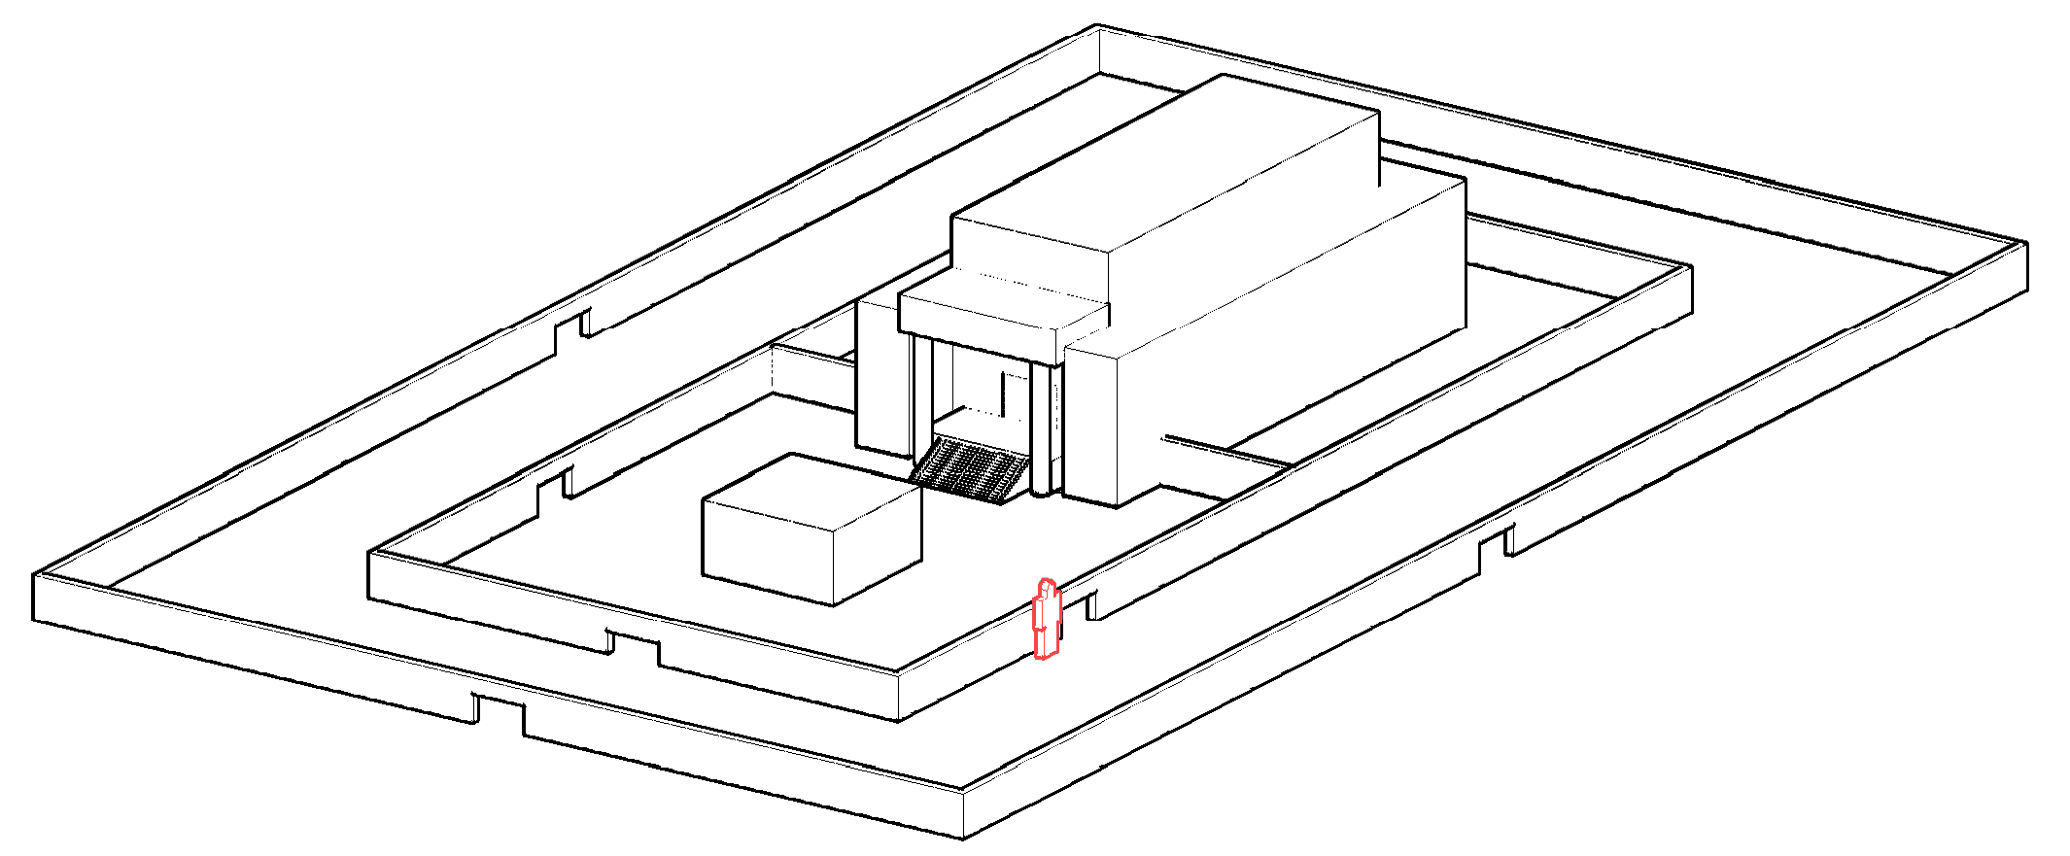
1st Challenge to Examine our hearts
Ezekiel 8v3-6
Temple
Altar
Idol of Jealousy

Slide 29
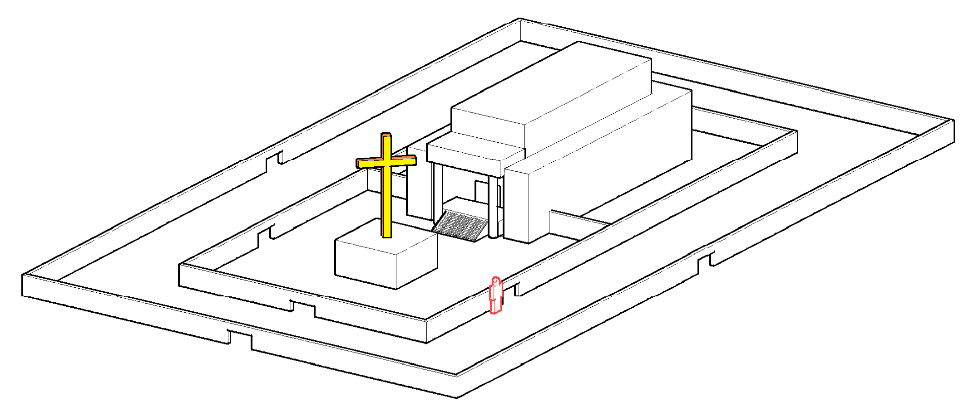
1st Challenge to Examine our hearts
Ezekiel 8v3-6
Temple
Temple
God dwelling with us
Altar
Idol of Jealousy

Slide 30

2nd Challenge to Examine our hearts
Ezekiel 8v7-12
Secret Idols

Slide 31
2nd Challenge to Examine our hearts
Ezekiel 8v7-12
“The LORD doesn’t see us”

Slide 32
2nd Challenge to Examine our hearts
Ezekiel 8v7-12
“The LORD doesn’t see us”

Slide 33
2nd Challenge to Examine our hearts
Ezekiel 8v7-12
“The LORD doesn’t see us”
Idolatry is reducing God to a size we are able to understand

Slide 34
3rd Challenge to Examine our hearts
Ezekiel 8v14
Wailing to Tamaz

Slide 35
3rd Challenge to Examine our hearts
Wailing to Tamaz
Ezekiel 8:14
Then he brought me to the entrance of the north gate of the house of the Lord, and I saw women sitting there, mourning the god Tammuz.

Slide 36
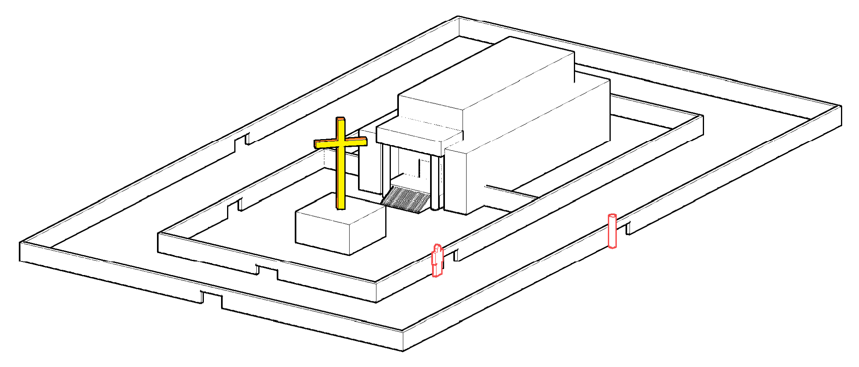
3rd Challenge to Examine our hearts
Ezekiel 8v14
Temple
Temple
God dwelling with us
Altar
North Gate
Wailing to Tamaz

Slide 37
3rd Challenge to Examine our hearts
Ezekiel 8:14
Wailing to Tamaz
Their emotions are captured by an idol

Slide 38
3rd Challenge to Examine our hearts
Ezekiel 8:14
Wailing to Tamaz
What are your emotions captured by?

Slide 39
3rd Challenge to Examine our hearts
Ezekiel 8:14
Wailing to Tamaz
What are you longing for?

Slide 40
3rd Challenge to Examine our hearts
Ezekiel 8:14
Wailing to Tamaz
What are you putting your confidence in?

Slide 41
3rd Challenge to Examine our hearts
Ezekiel 8:14
Idolatry is the graffiti of satan written across
humanity putting their confidence in something else
‘The Ten Commandments for today’, Brian Edwards

Slide 42

4th Challenge to Examine our hearts
Sun Worship
Ezekiel 8:16
He then brought me into the inner court of the house of the Lord, and there at the entrance to the temple, between the portico and the altar, were about twenty-five men. With their backs toward the temple of the Lord and their faces toward the east, they were bowing down to the sun in the east.

Slide 43
4th Challenge to Examine our hearts
Sun Worship
Ezekiel 8:16
Temple
God dwelling with us
Altar
North
East

Slide 44
4th Challenge to Examine our hearts
Sun Worship
Ezekiel 8:16
Romans 1:25
They exchanged the truth about God for a lie, and worshipped and served created things rather than the Creator

Slide 45
4th Challenge to Examine our hearts
Sun Worship
Ezekiel 8:16
Temple
God dwelling with us
Altar
North
East

Slide 46
Ezekiel 8:6
And He said to me, “Son of man, do you see what they are doing—the utterly detestable things the Israelites are doing here, things that
will drive Me far from my sanctuary?

Slide 47
Ezekiel 11:17-20 PROMISE
… This is what the Sovereign LORD says;
“I will gather you from the nations and bring you back from the countries where you have been scattered, and I will give you back the land of Israel again. They will return to it and remove all their vile images and detestable idols. I will give them an undivided heart and put a new spirit in them. I will remove from them their heart of stone and give them a heart of flesh. Then they will follow my decrees and be careful to keep my laws. They will be my people, and I will be their God.”

