Slide 1

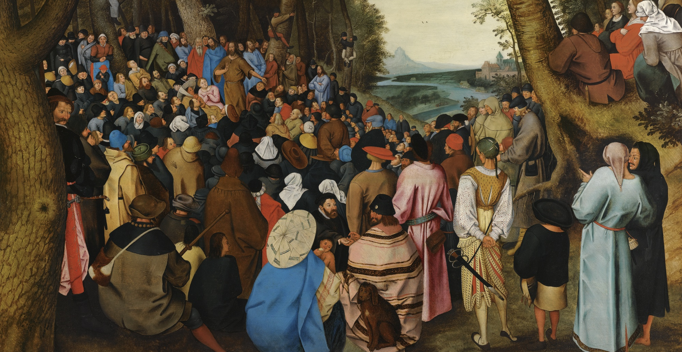


How to Repent Properly
Luke 3:1-20
z
z

Slide 2
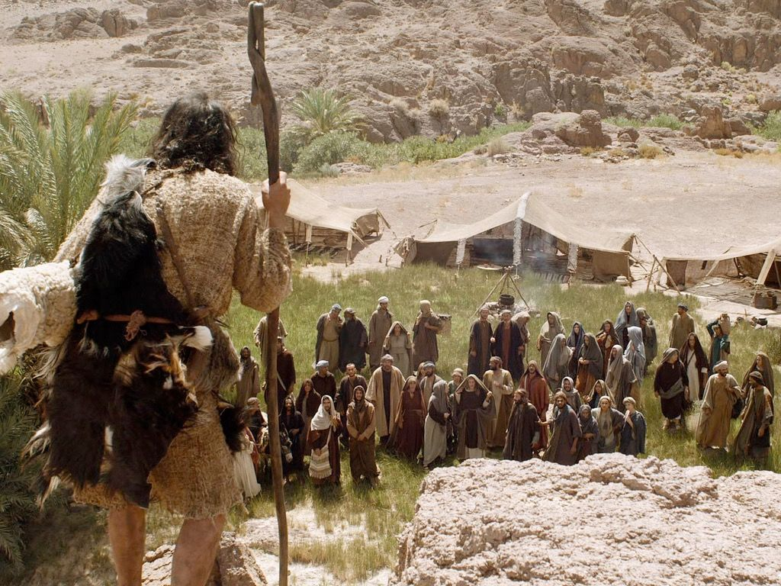
Luke 3:1-20
z
26 A.D. (approximately)
Caesar Tiberius to Caiaphas the High Priest
The son of Zechariah and Elizabeth in the desert
Baptising and challenging
Imprisoned by Herod Antipas for his efforts

Slide 3
Proper Repentance
Not just outward ceremony or rituals
A changed inner attitude and outward actions
It determines who is in and who is out
It is a gift of the Holy Spirit
Repentance and faith go together
The church must repent too

Slide 4
Embrace the good news of repentance

