Slide 1
Extraordinary news for ordinary people
Luke 2:1-21

Slide 2
Who’s who?
The great:
Caesar Augustus, Quirinius
The ordinary:
Mary & Joseph,
Shepherds,
Villagers
The Lord:
Jesus the Christ

Slide 3

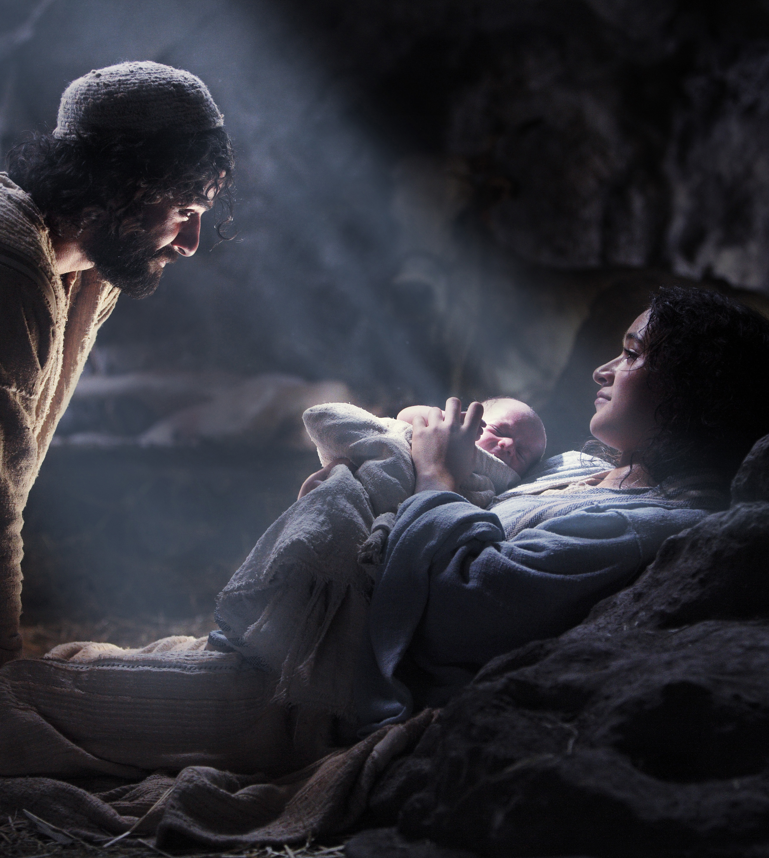
The baby to respond to
Saviour of the world
Christ the Lord
Good news for everyone

