Slide 1

“Serving the Communities of China
with Hope and Love”
Notes:
[ME]
Good morning, it is great to be here today
(Introduce us)
Today we want to share a little about our time in Kunming, China
Who here is from China?
Is there anyone from Kunming or Yunnan?

Slide 2
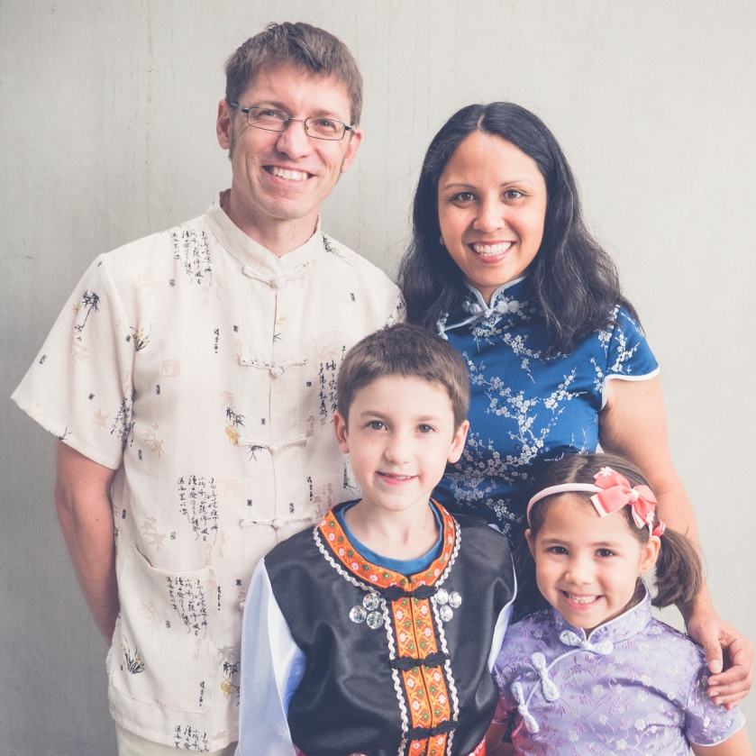
Mark, Joanne, Micah & Kiera
Sharing about our time in Kunming, China
Notes:
[ME]
Good morning, it is great to be here today
(Introduce us)
Today we want to share a little about our time in Kunming, China
Who here is from China?
Is there anyone from Kunming or Yunnan?

Slide 3
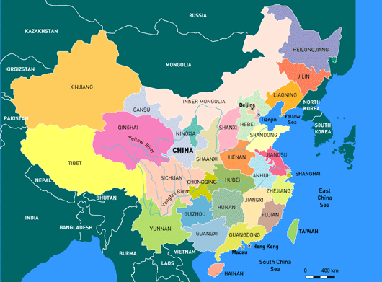
Notes:
[Jo]
Where we were. (describe)

Slide 4
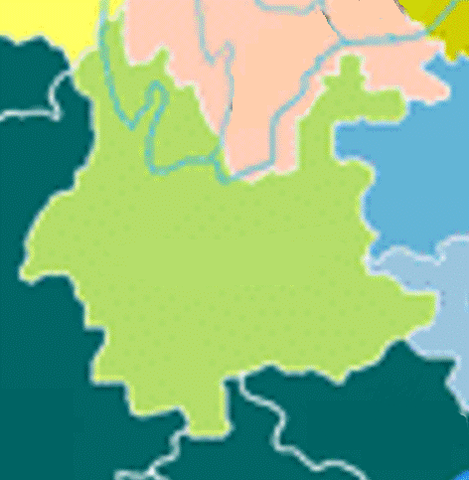
TIBET
西藏
SICHUAN
四川
GUIYANG
贵阳
昆明 Kunming
YUNNAN
云南
GUANGXI
MYANMA
缅甸
VIETNAM
越南
LAOS
老挝
Notes:
[Jo]
Where we were. (describe)
[KM a “small city” with 8 million people]

Slide 5
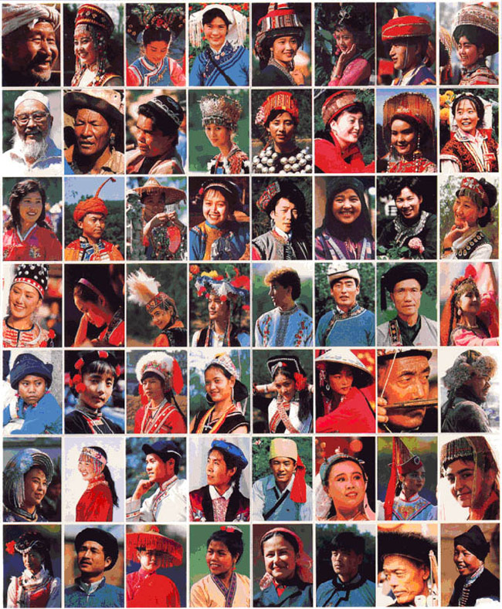
56 official Minorities in China. 26 found in Yunnan Province Kunming (capital of Yunnan)– Population 8 million
Notes:
[ME] One of the special things about Yunnan is there are many (shaoshu minzu) people groups. They all have different culture, language and ethnicity.
The majority in China are “Han”, but there are 56 official minority groups in China,
26 of which were in the province where we lived – Yunnan.

Slide 6
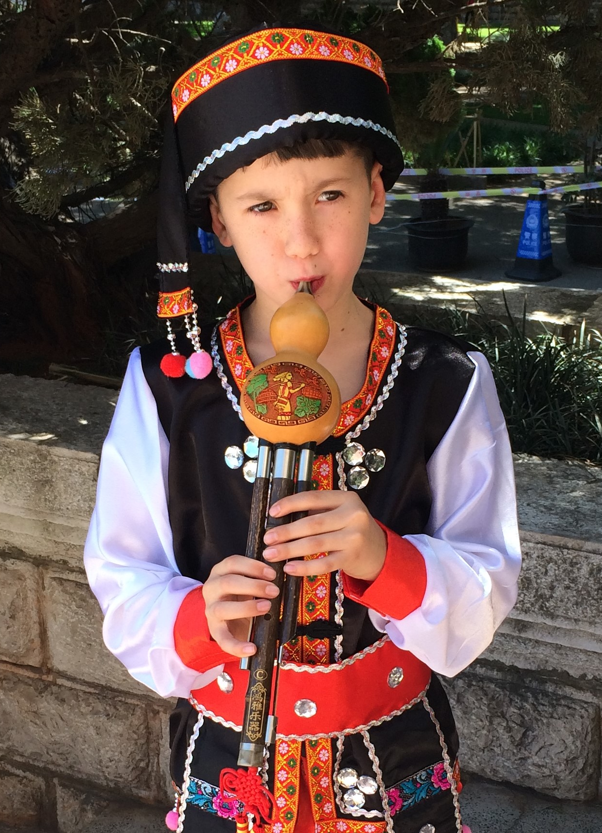
Notes:
[ME]
(The minority groups had colourful traditional clothes. (in this photo) My son Micah is wearing the costume from the Dai minority group and he has been learning the Hulusi is a traditional musical instrument which is also from the Dai minority group.
God put many people into our lives, including people from different people groups.
As a family we had a heart for the minority groups, especially when we discovered that some have never heard about Jesus.

Slide 7
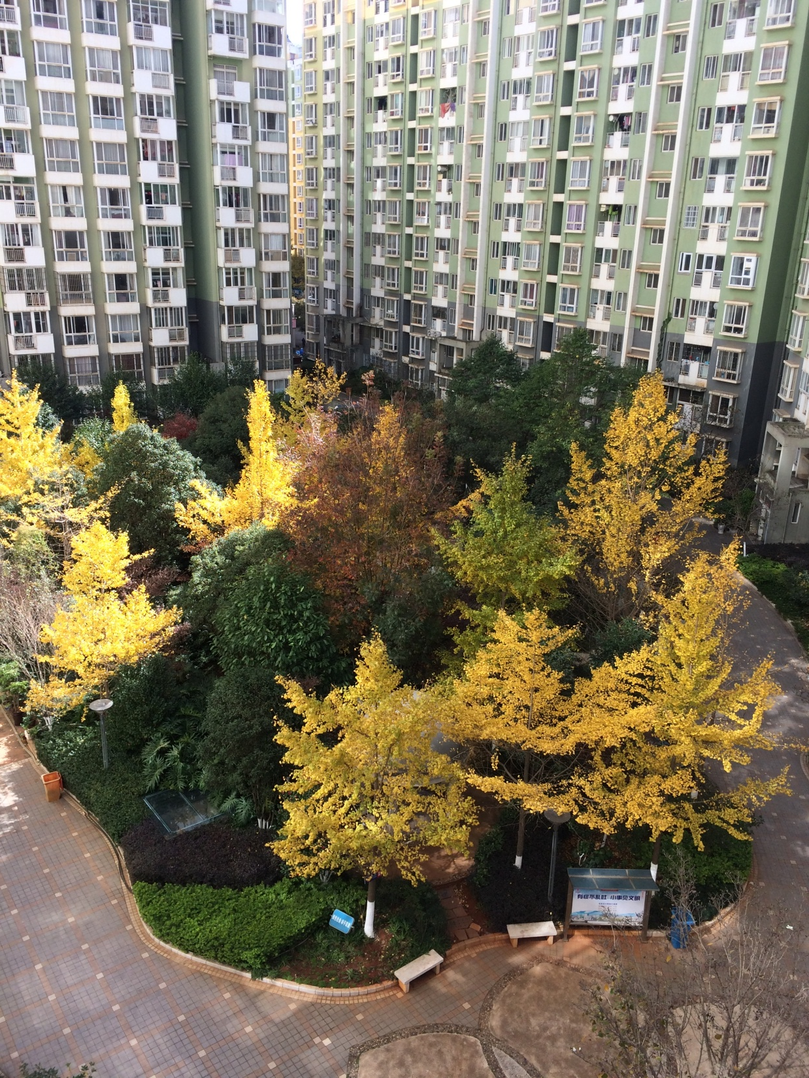
Notes:
[ME] Houses are very different to NZ. Most of the new apartment blocks in KM are over 30 stories high.
The apartment complex where we stayed was 17 stories high. Around this courtyard would have been about 400 apartments, with atleast 1000 people there. We loved the courtyard. It was a great place for our children to play and also a great place to meet our neighbours.

Slide 8
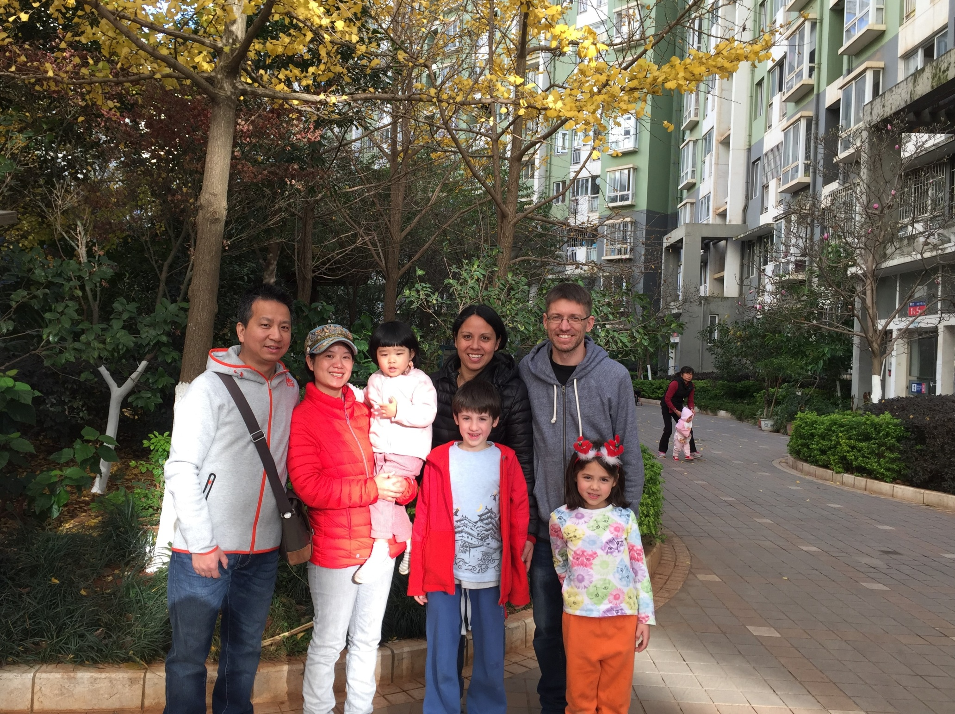
Notes:
[Jo]
Neighbours (Kiera playing with RuiRui)

Slide 9
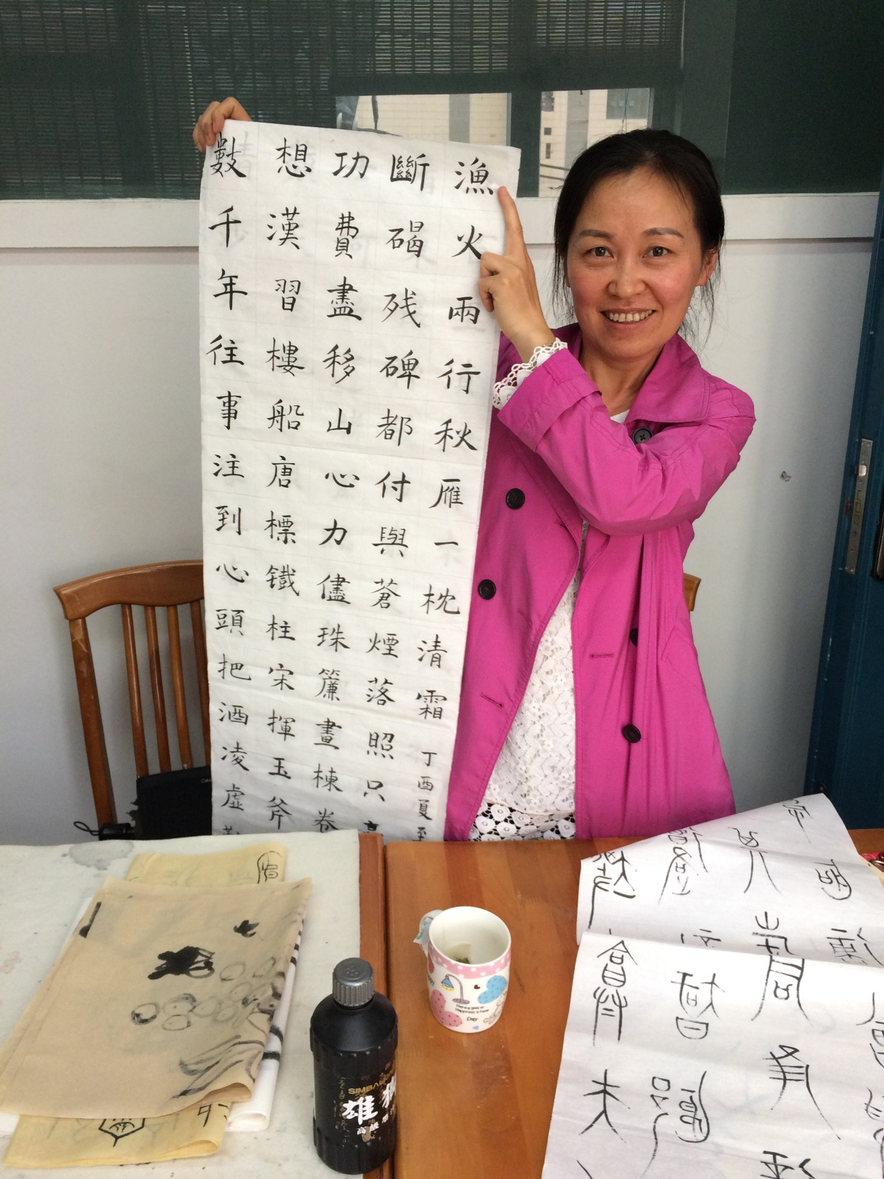
Notes:
[ME]
We went to China on a student visa. So officially we went to China to study mandarin.
I studied at a small language school, one on one.
This is a photo of one of my teachers. Usually we would sit at this desk with a Chinese text books and I would learn listening, speaking, reading and writing.
But because I had passed HSK4 exam my teacher also gave me one lesson, teaching me Chinese calligraphy, which was a hobby of hers.

Slide 10
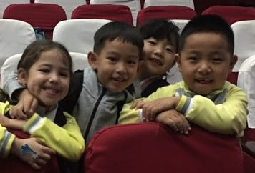
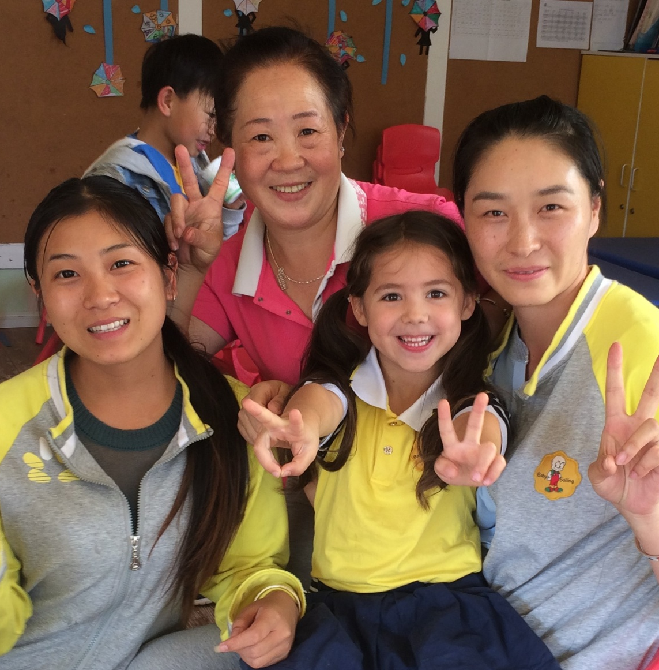
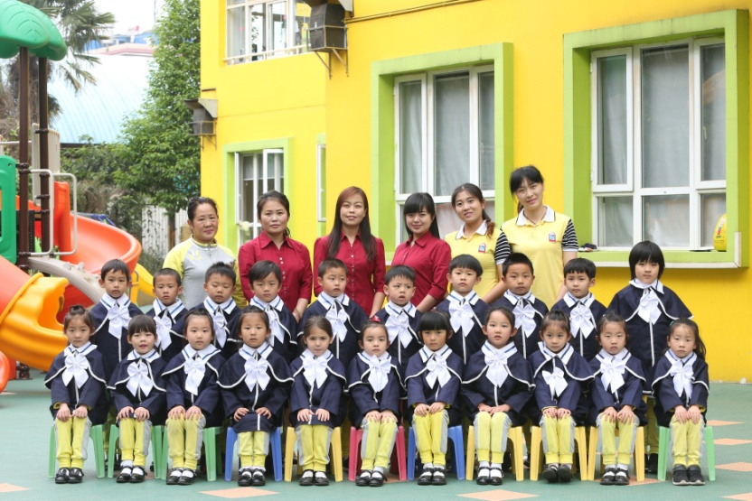
Chinese Kindergarten
Notes:
[Jo]
Chinese Kindergarten
Kiera’s language

Slide 11
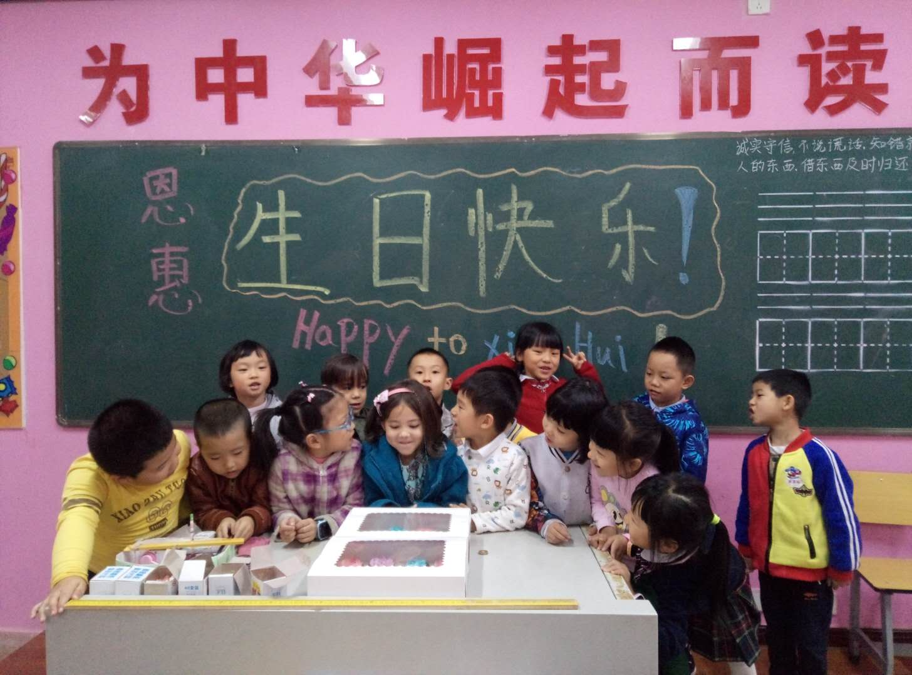
Chinese Primary School - Kiera
Notes:
[Jo]

Slide 12
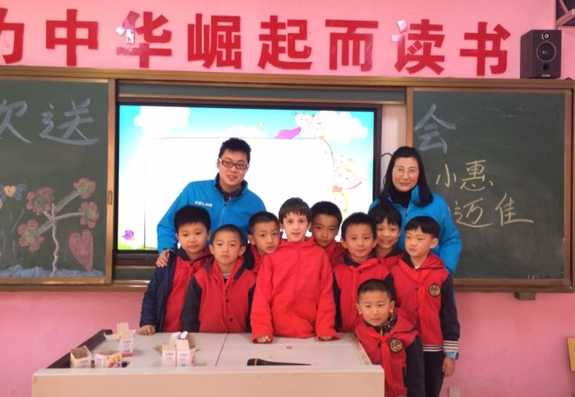
Chinese Primary School - Micah
Notes:
[Jo]
School – Micah
(He had a heart for minority groups)

Slide 13
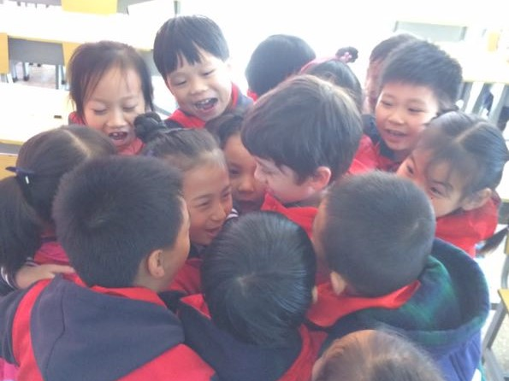
Notes:
[Jo]
(Micah’s last day – loved by his classmates)

Slide 14
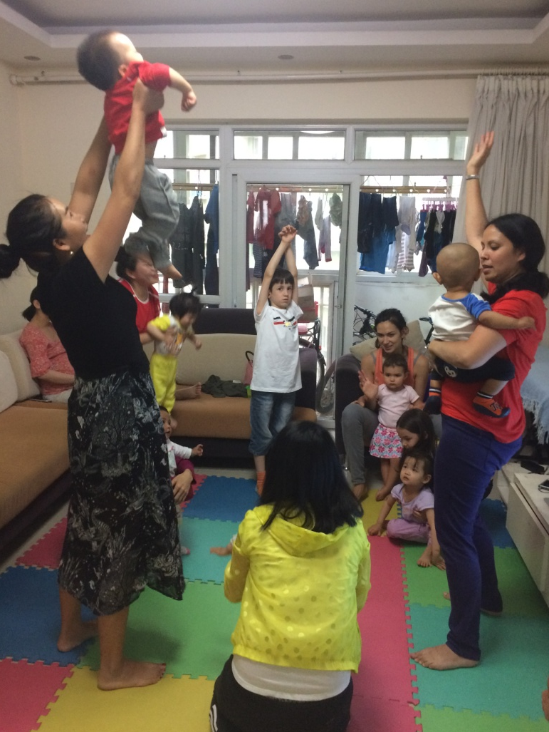
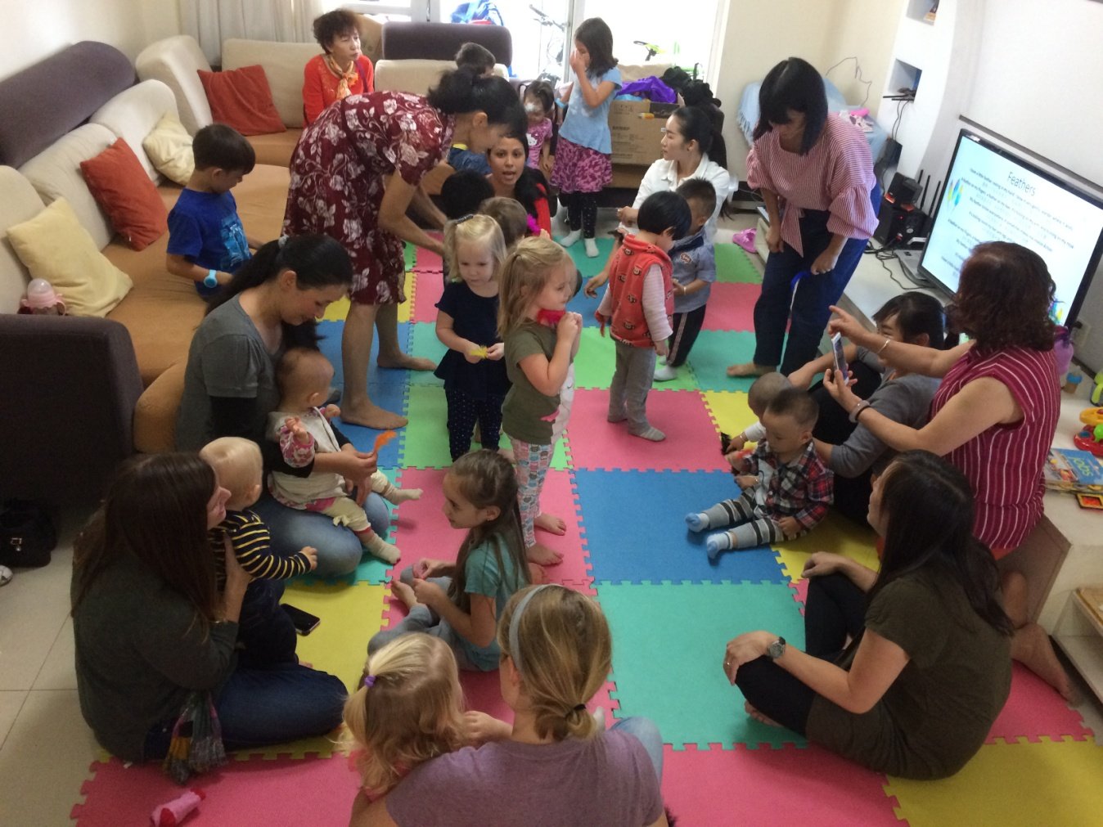
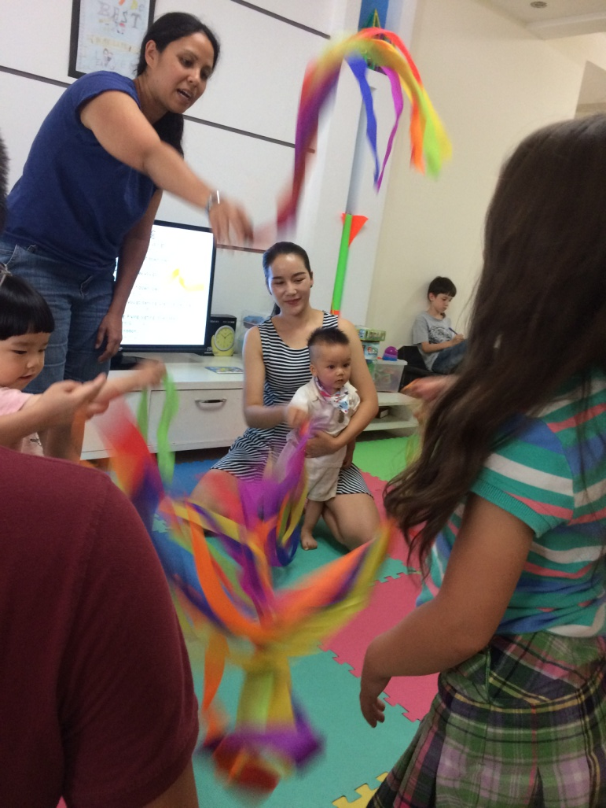
Musicise
Music and Movement
Community Outreach
Notes:
[Jo]
God gave us many opportunities - eg. Musicise
(explain what you did in musicise)

Slide 15
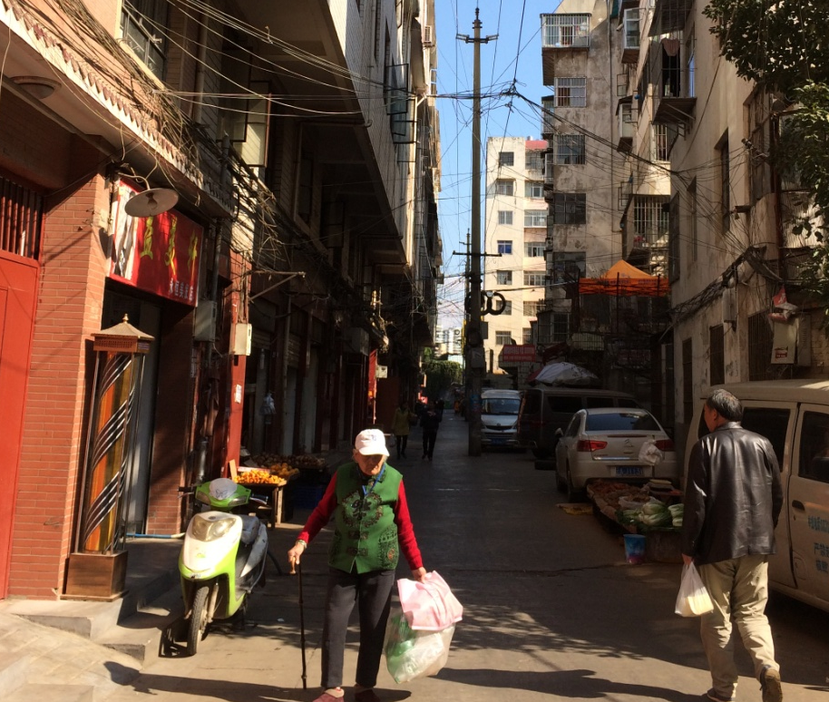
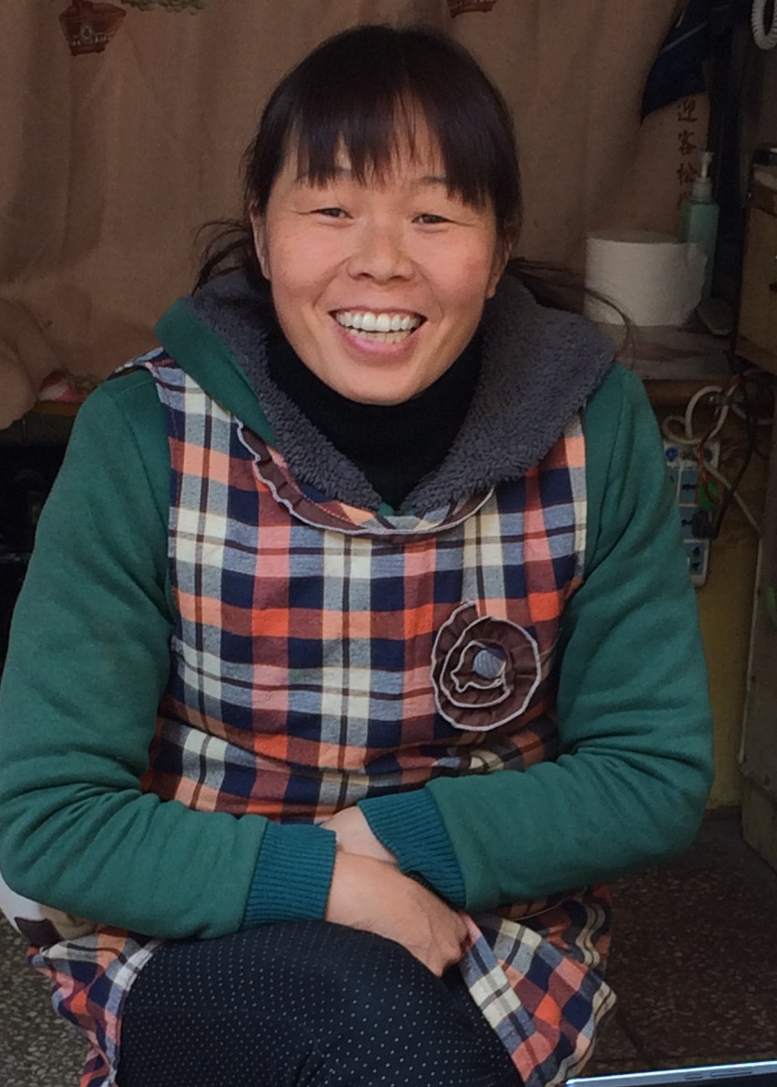
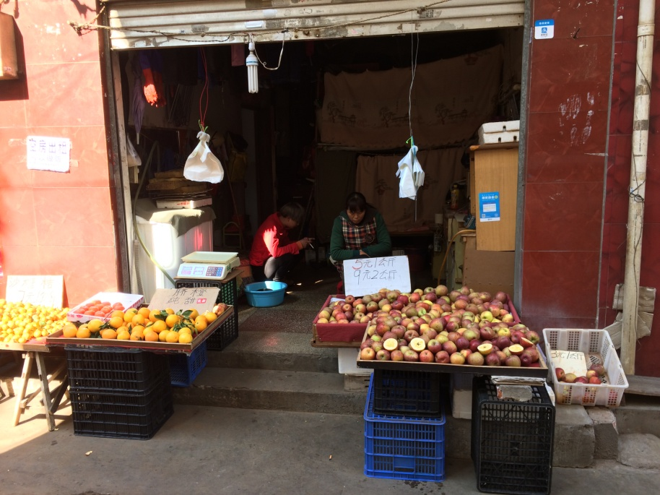
Notes:
[Jo]
(Micah’s last day – loved by his classmates)

Slide 16
What God Placed on our Hearts
Unreached and Unengaged People Groups (UPGs)
Importance of Relationships
Encourage, support, disciple & mentor other Christians – local Chinese and other foreigners
Notes:
[Jo]
[ME]
[Jo]

Slide 17
What next…..
?
Notes:
What next?
We feel God leading us back to China
But what will that look like?
At this stage we are looking to be back in NZ this year, and return to China early next year

Slide 18

PRAY
That we would trust in God’s timing for returning to China
That we would use our time well in NZ to prepare
That God would go before us and prepare hearts
That relationships we have formed would continue to be able to be built upon even from a distance
For support to be raised for us to return long-term
For our brothers and sisters in China
Notes:
(each read one point alternately)

Slide 19
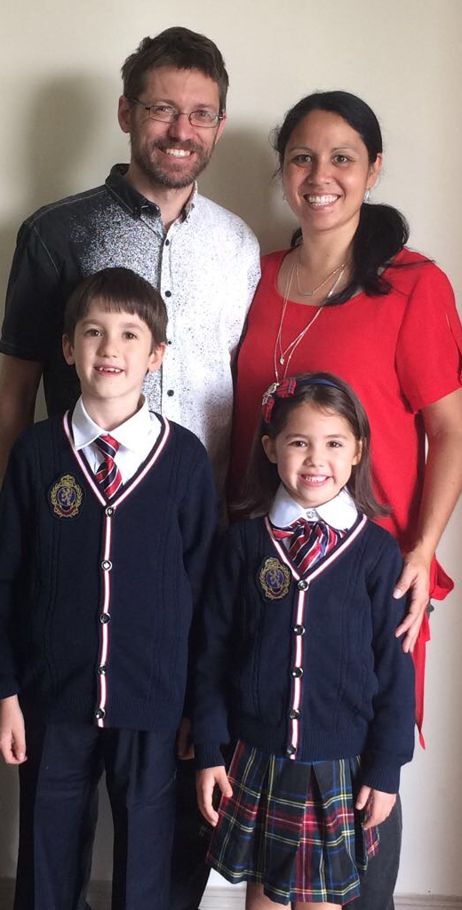
Thank you for your support!
Notes:
[Jo] Thank you for your support….
Supporters cards

