Slide 1
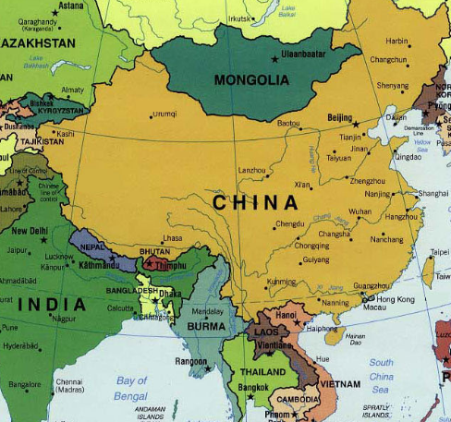
China
Mark visited China in 2004
Returned in 2005 to study Chinese for 9 months
We all visited in May 2015

Slide 2
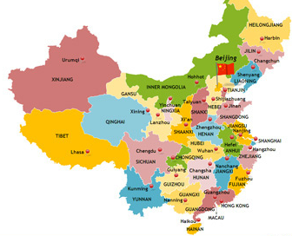
Kunming 昆明
Capital of Yunnan province which borders Myanmar, Laos & Vietnam
Population: 8 million
25 official people groups

Slide 3
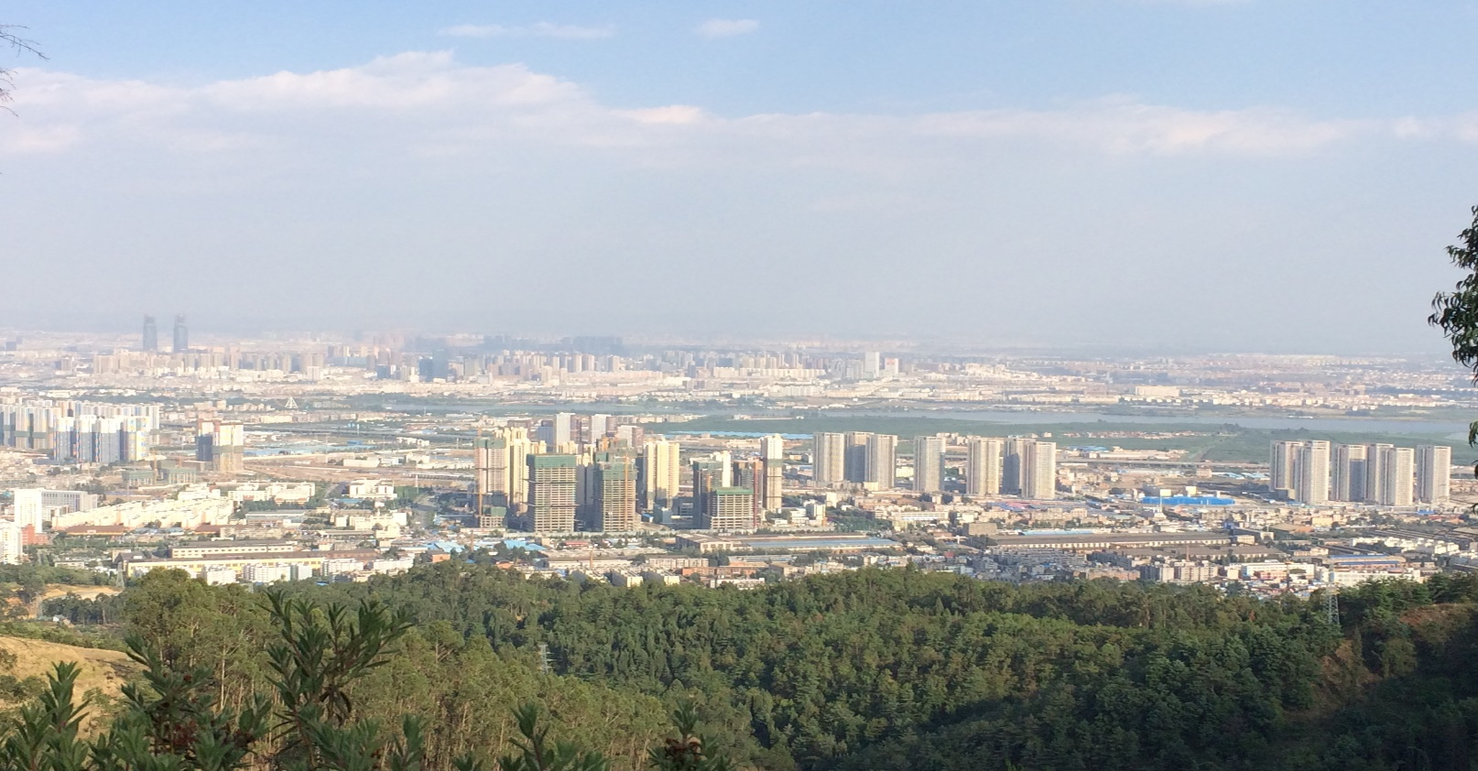
We went to China with many questions
Is this where God is leading us?
Kunming

Slide 4
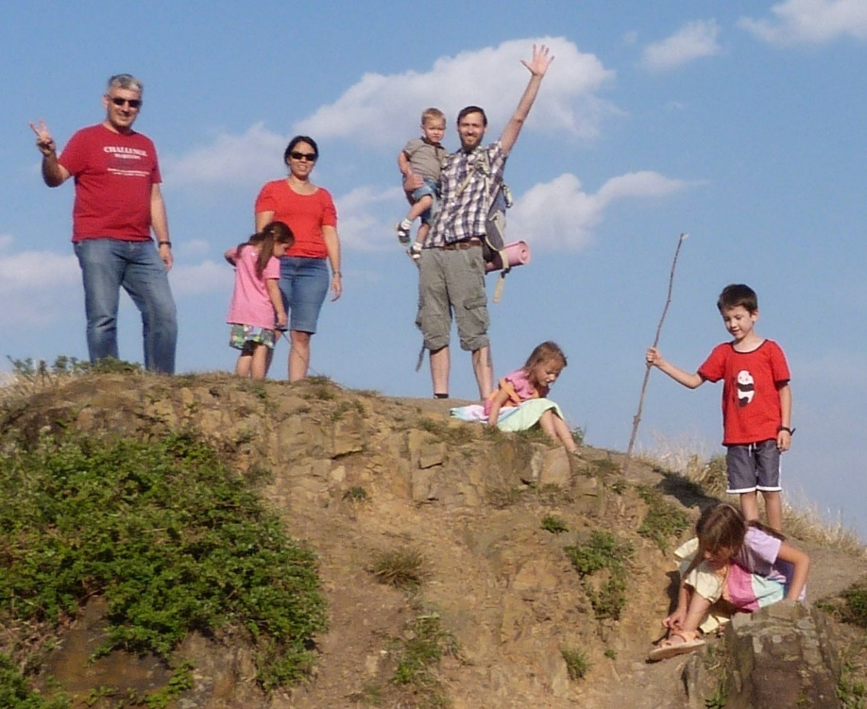
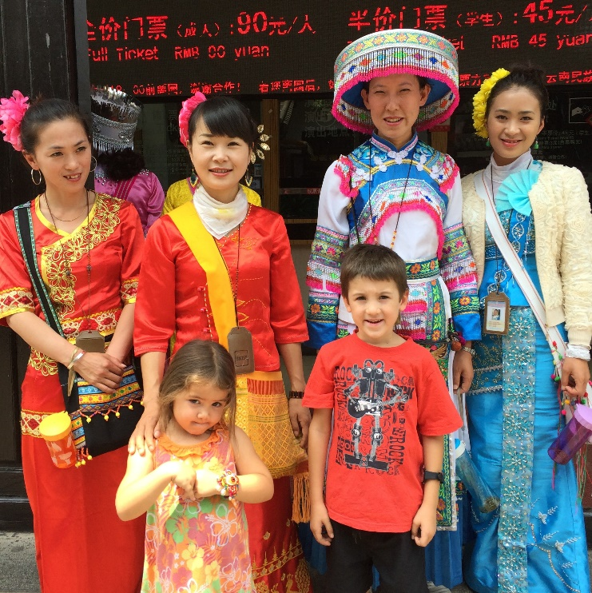
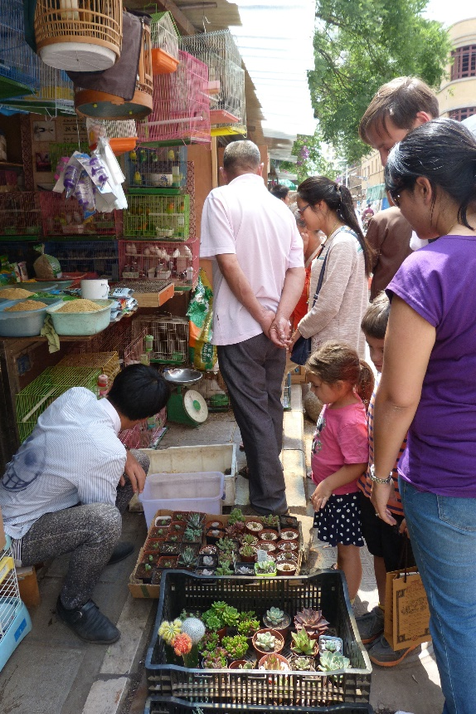
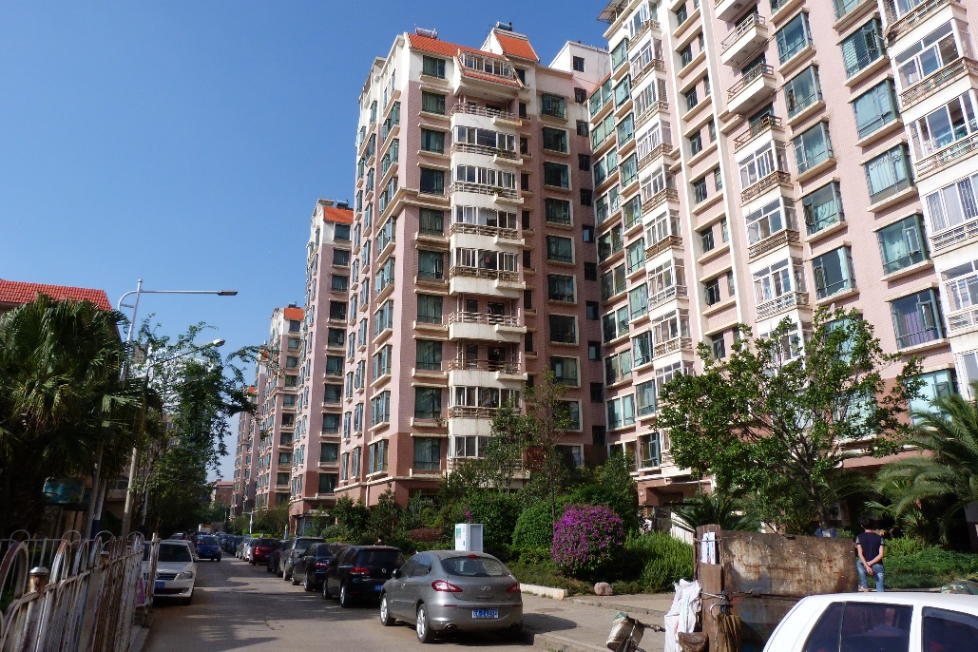
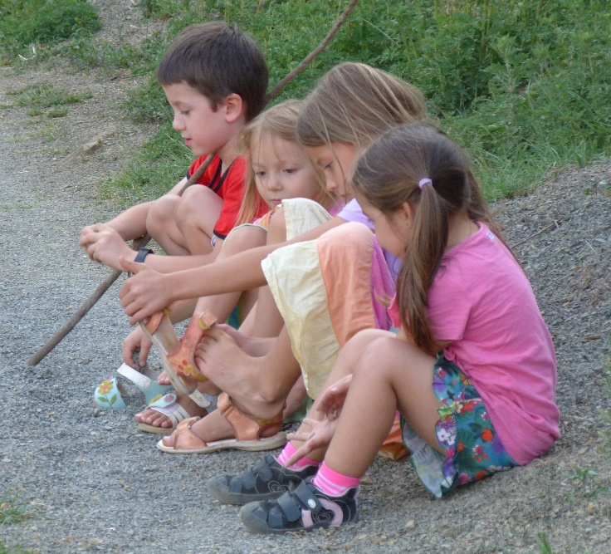
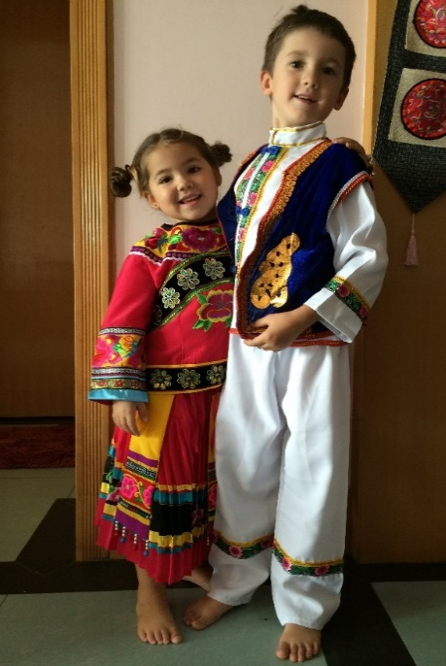
By the time we left, God had answered all our questions

Slide 5
What does God want us to do there?

Slide 6
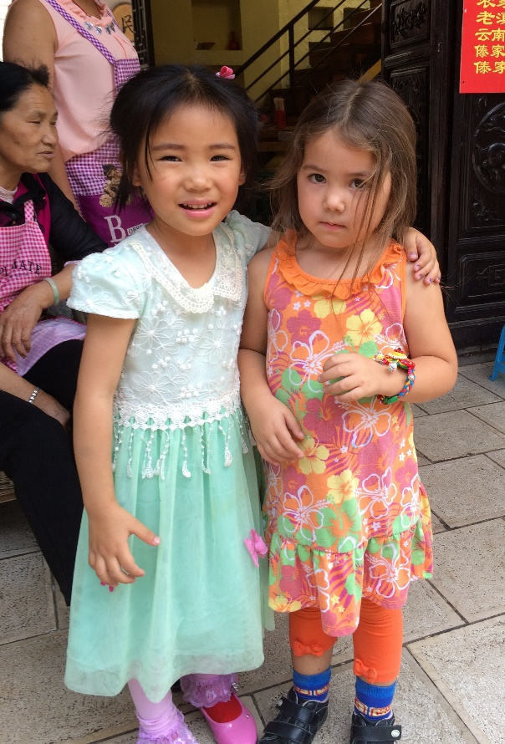
What does God want us to do there?
To get alongside others
& build relationships

Slide 7
What does God want us to do there?
To get alongside others
& build relationships
Discipling
Encouraging
Equipping (inc. parenting & family life)
For 2 years
Language study (Mark)

Slide 8
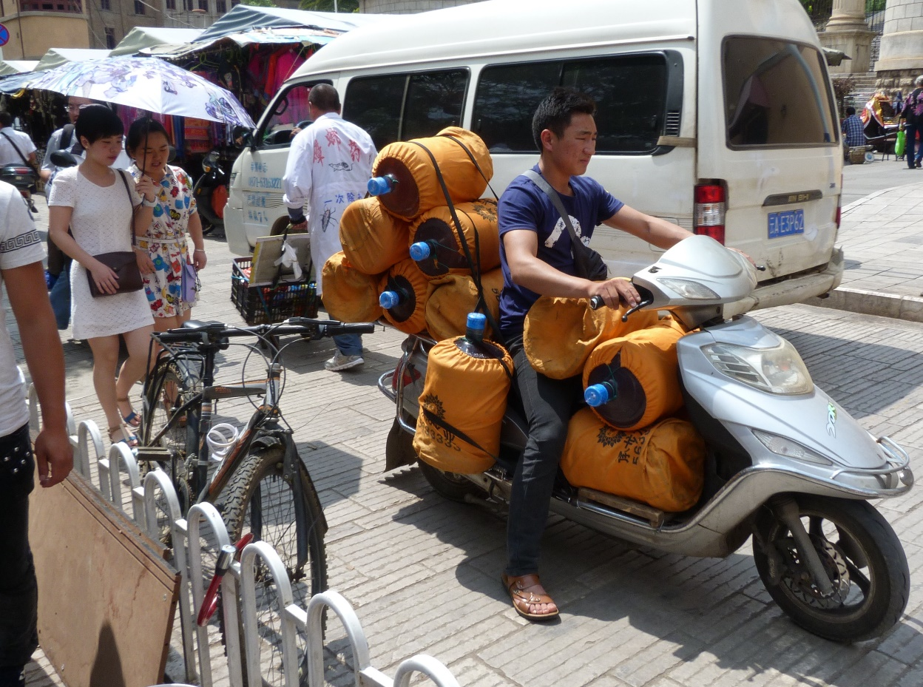
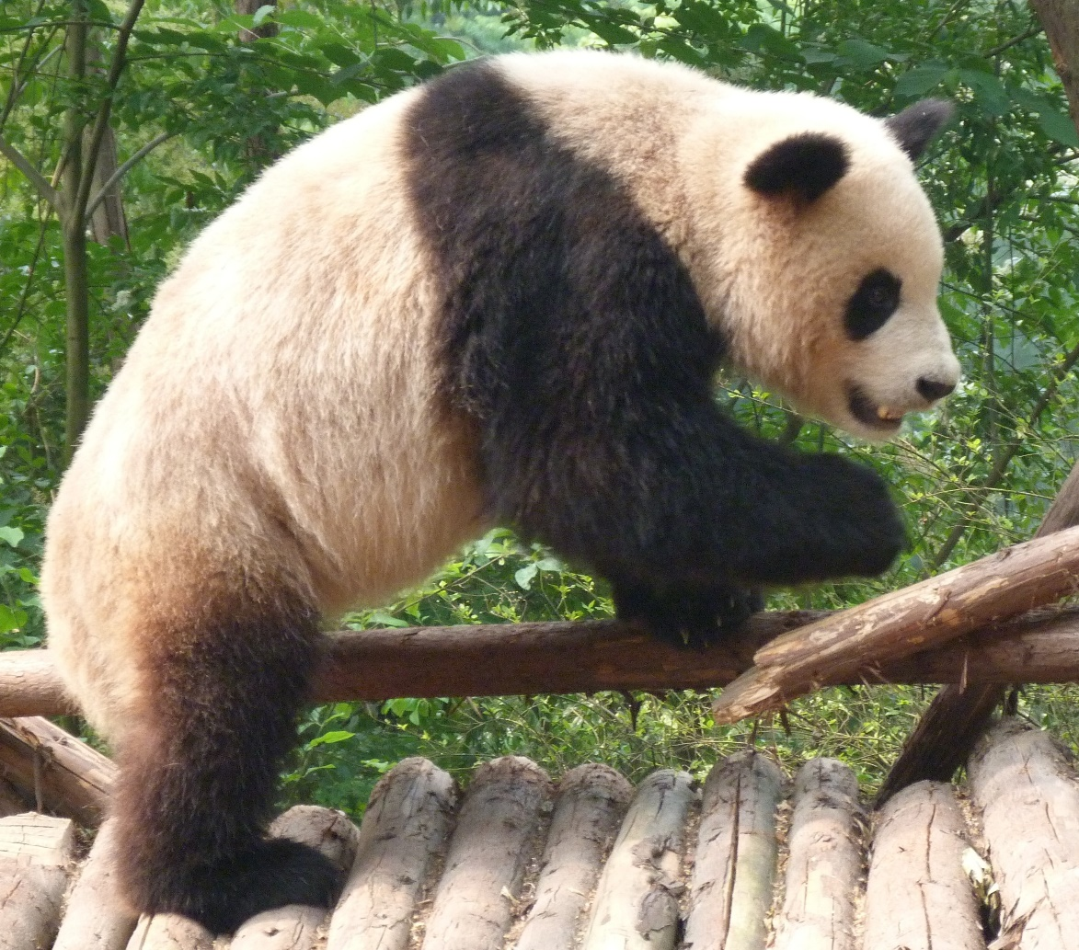

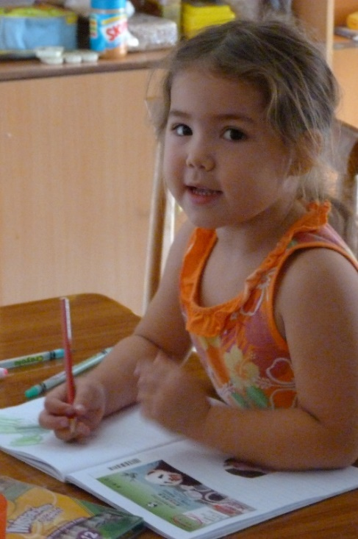
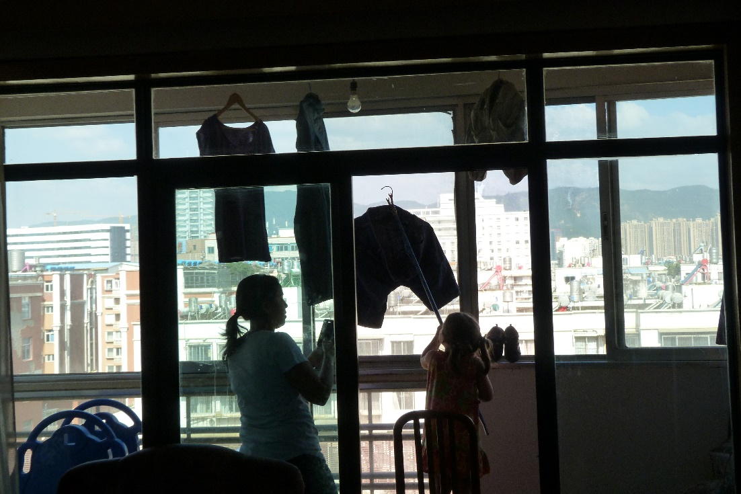
Challenges
学中文很难

Slide 9
Challenges
Financial Support
Language
Schooling for children
Balancing family and ministry
Cultural understanding
and adjustment

Slide 10
Pray for
Financial Support
Language
Schooling for children
Balancing family and ministry
Cultural understanding
and adjustment

Slide 11

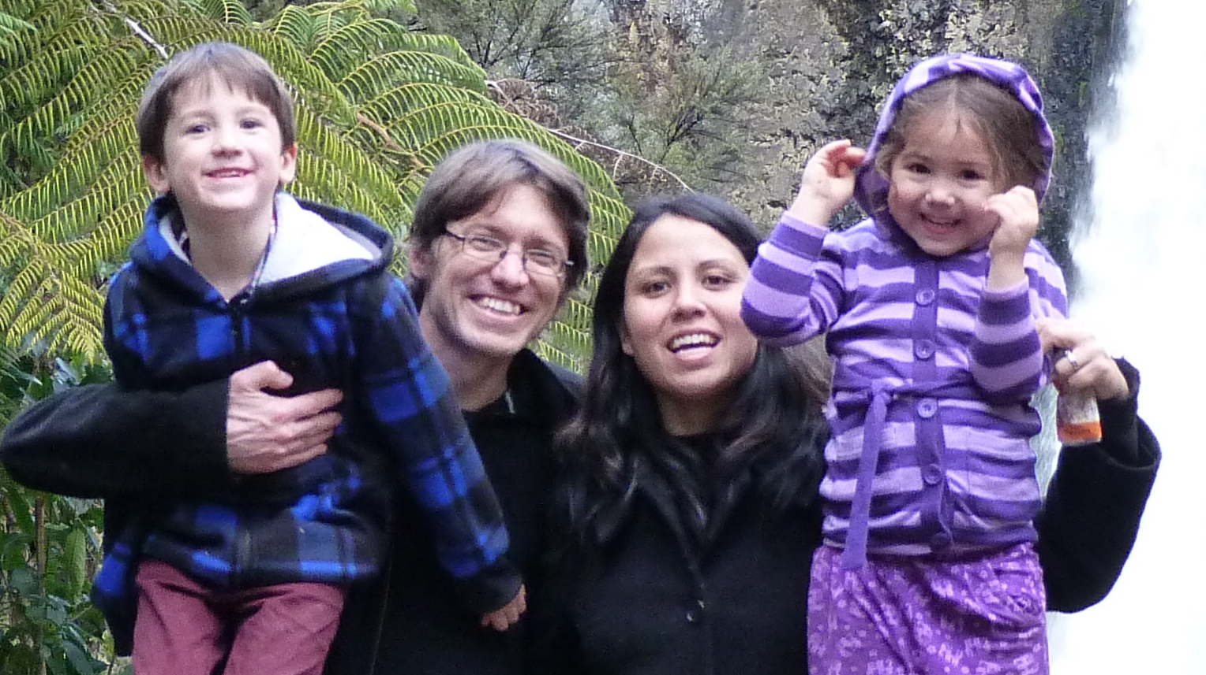
“Serving the Communities of China with Hope and Love”
Email: markandjo@gmail.com
Newsletter and support information at the back

